Slide 1
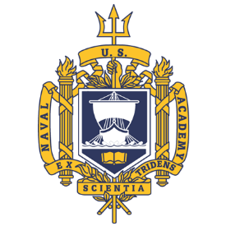
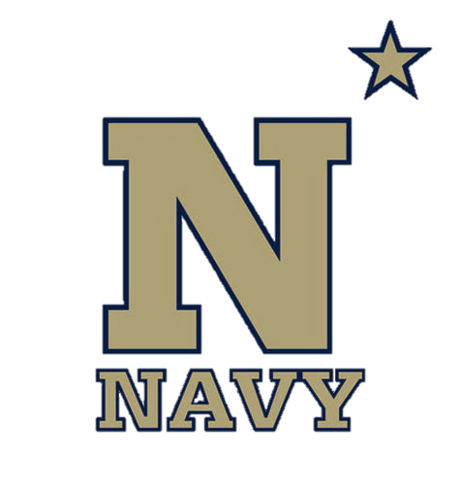
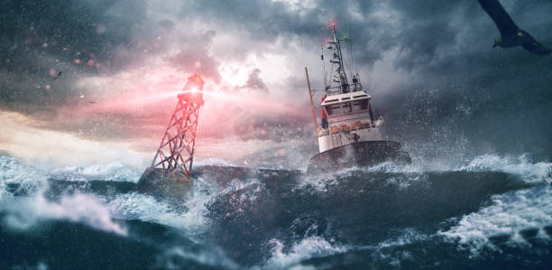
Emergency Navigation
NN220-17
SEANAV I United States Naval Academy
NN220 – Fundamentals of Navigation– Updated May 2023
Operations Officer I HMS PROTECTOR A173 I The Ice Patrol Ship

Slide 2
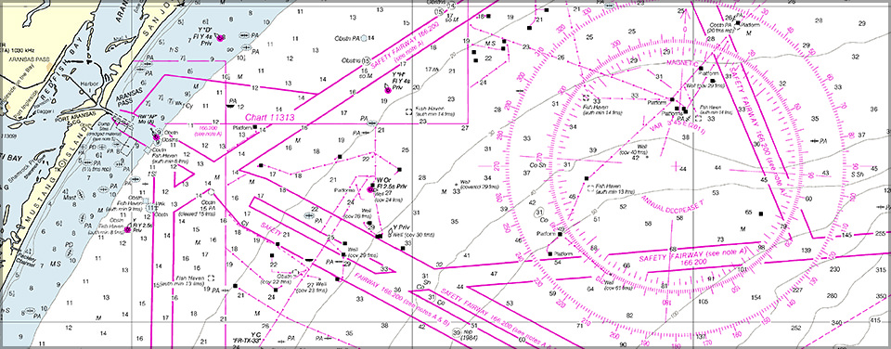
References
-The American Practical Navigator, Pub. No. 9, Bowditch, VOL. 1, 2019 Edition -Surface Ship Navigation Department Organizations and Regulations Manual (NAVDORM), COMNAVSURFPAC/COMNAVAIRPAC/COMNAVAIRLANT/COMNAVSURFLANT INSTRUCTION 3530.4 series
SEANAV I United States Naval Academy
NN220 – Fundamentals of Navigation
Operations Officer I HMS PROTECTOR A173 I The Ice Patrol Ship

Slide 3
Enabling Objectives
1 – DESCRIBE how to plan for navigational emergencies when at sea. 2- DESCRIBE the contents of an emergency navigation kit. 3 - DEFINE the Most Probably Position (MPP) and understand how to determine MPP. 4 - UNDERSTAND how Dead Reckoning applies to emergency navigation. 5 - DETERMINE the ship’s direction using Polaris, Meridian Transit, Body on Prime Vertical, and Body at Rising or Setting methods. 7 - UNDERSTAND how Celestial Navigation applies to emergency navigation. 8 - DETERMINE Latitude by Meridian Altitude, Latitude by Polaris, the Length of the Day, and the Body In Zenith methods. 9 - DETERMINE Longitude by Time of Transit method. 10 - UTILIZE concepts learned in the course to determine mitigating factors to avoid an emergency at sea.
SEANAV I United States Naval Academy
NN220 – Fundamentals of Navigation
Operations Officer I HMS PROTECTOR A173 I The Ice Patrol Ship

Slide 4
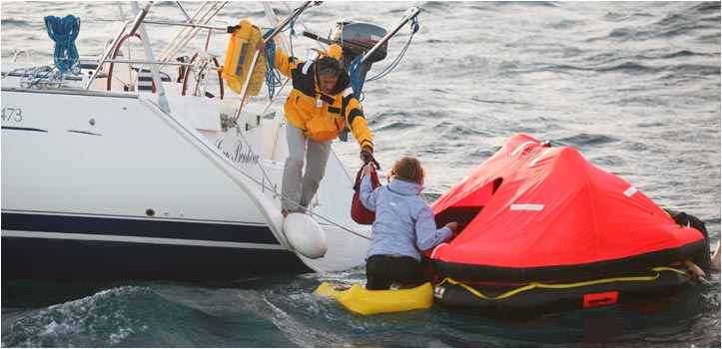
Planning for Emergencies
-Increasing reliance on electronic navigation and communication systems has drastically changed the perspective of Emergency Navigation.
-No Navigator should ever become completely dependent on electronic methods.
-For offshore voyaging, ships need to be thoroughly familiar with the theory and practice of CELNAV.
SEANAV I United States Naval Academy
NN220 – Fundamentals of Navigation
Operations Officer I HMS PROTECTOR A173 I The Ice Patrol Ship

Slide 5
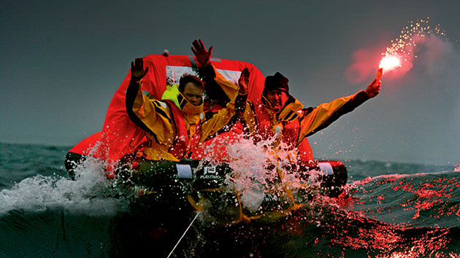
Planning for Emergencies
-The likeliness of a loss of an Electronic Navigation system is greater than a need to abandon ship. However, prepare for all scenarios.
-Ships must be prepared to navigate without the luxury of advanced electronic systems.
-Being prepared with backup systems, paper charts, CELNAV instruments and essential publications will ensure that a ship can mitigate most emergencies.
SEANAV I United States Naval Academy
NN220 – Fundamentals of Navigation
Operations Officer I HMS PROTECTOR A173 I The Ice Patrol Ship

Slide 6
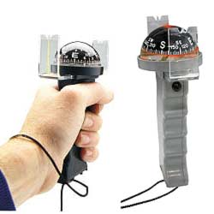
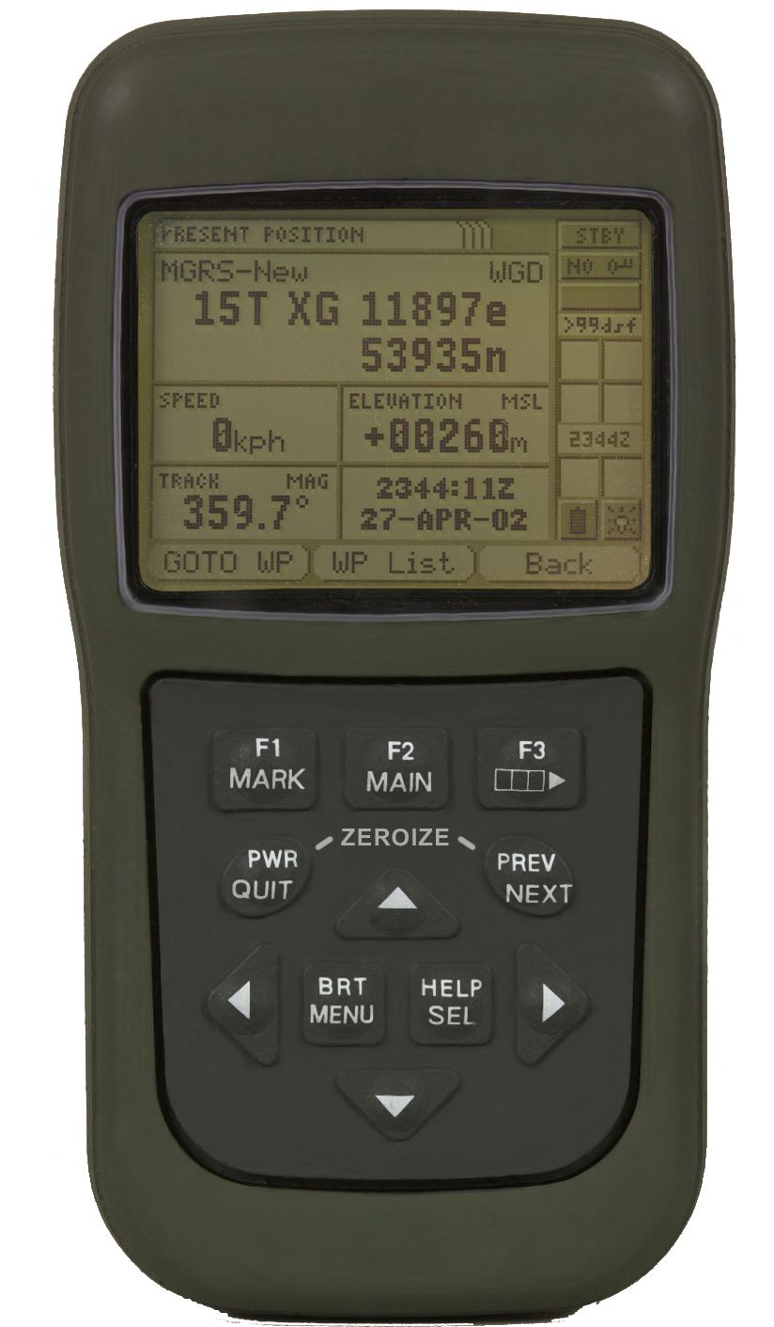
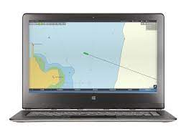
Emergency Navigation Kit
-The Navigator should assemble a kit containing equipment for emergency navigation. This kit should contain:
1-At least one handheld GPS receiver.
2-A magnetic hand bearing compass.
3-Minimal set of paper charts for the voyage at hand.
(U.S. Navy ships will have an ENL which meets
the redundancy of paper charts)
SEANAV I United States Naval Academy
NN220 – Fundamentals of Navigation
Operations Officer I HMS PROTECTOR A173 I The Ice Patrol Ship

Slide 7
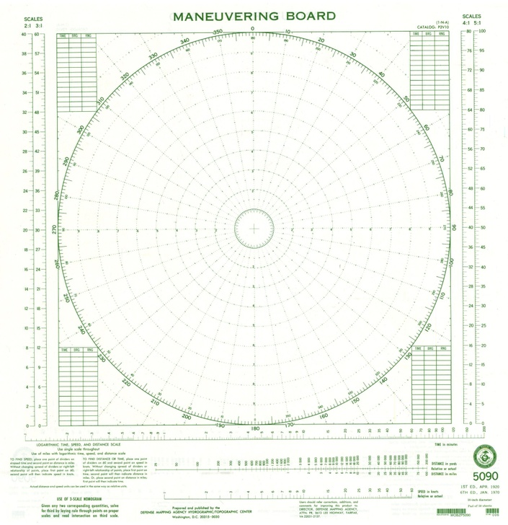
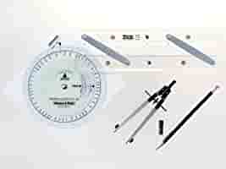
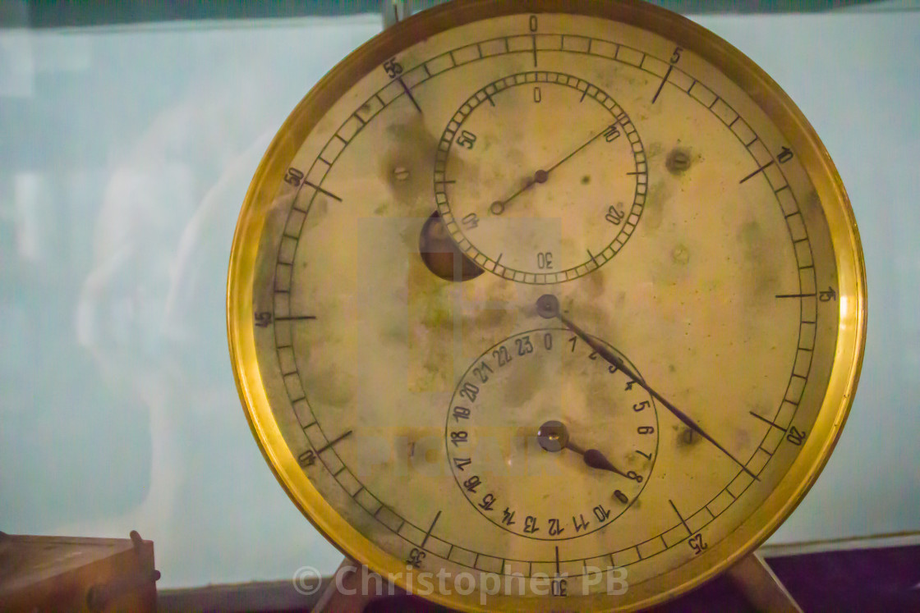
Emergency Navigation Kit
-The Navigator should assemble a kit containing equipment for emergency navigation. This kit should contain:
4-Deck Log, MoBoards, Graph Paper
and Plotting Sheets.
5-Standard NAVKIT
6-Accurate Timepiece
SEANAV I United States Naval Academy
NN220 – Fundamentals of Navigation
Operations Officer I HMS PROTECTOR A173 I The Ice Patrol Ship

Slide 8
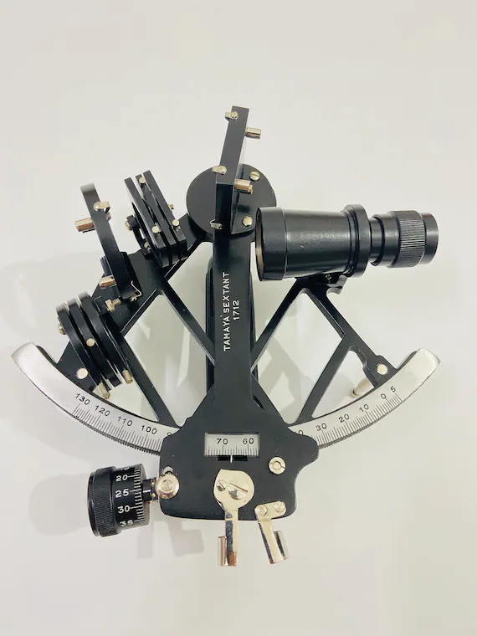
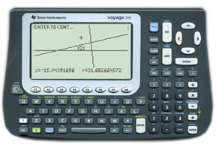
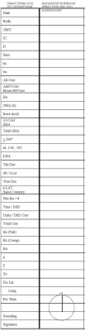
Emergency Navigation Kit
-The Navigator should assemble a kit containing equipment for emergency navigation. This kit should contain:
7-Marine Sextant
8-CELNAV Calculator and/or
Nautical Almanac
9-Strip Forms/Sight Reduction
Tables
SEANAV I United States Naval Academy
NN220 – Fundamentals of Navigation
Operations Officer I HMS PROTECTOR A173 I The Ice Patrol Ship

Slide 9
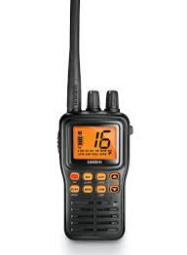
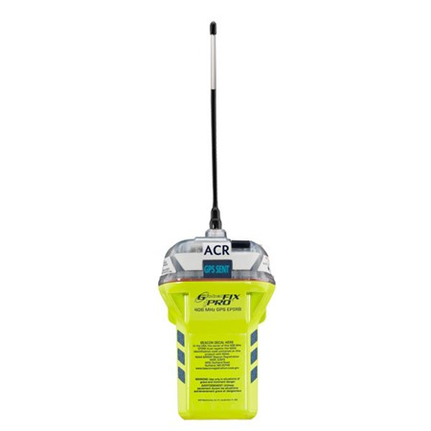
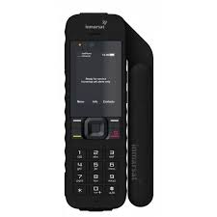
Emergency Navigation Kit
-The Navigator should assemble a kit containing equipment for emergency navigation. This kit should contain:
10-Flashlight
11-Portable VHF RADIO
12-Emergency Position Indicating Radiobeacon (EPIRB)
13-SAT PHONE
SEANAV I United States Naval Academy
NN220 – Fundamentals of Navigation
Operations Officer I HMS PROTECTOR A173 I The Ice Patrol Ship

Slide 10
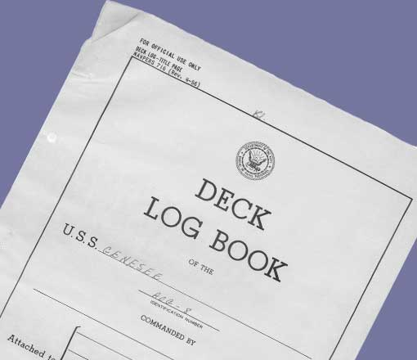
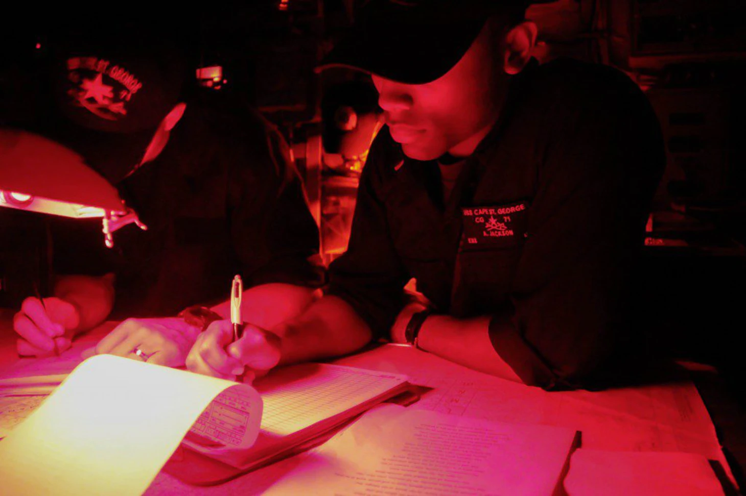
Deck Log
-At the onset of a navigation emergency, a navigation log should be started if the deck log is not already maintained. -Note the date and time of the casualty. -Enter in initial navigation information to include ship’s position, status of all navigation systems, decisions made and any reasons why those decisions were made. -The best determination of position when casualty occurred should be noted, followed by a full account of courses, distances, positions, winds, currents, etc. -Leave no important navigation information to memory.
SEANAV I United States Naval Academy
NN220 – Fundamentals of Navigation
Operations Officer I HMS PROTECTOR A173 I The Ice Patrol Ship

Slide 11
Emergency Navigation
-The moment that an emergency occurs, the prudent Navigator should use all means to establish a position.
-If GPS is still available, fixing your position should remain relatively unchanged.
-However, in a situation where there is a significant loss or degradation of navigation sensors, a Navigator needs to find a position without reliable sources.
-In an emergency situation, a degree of error may have to be acceptable.
SEANAV I United States Naval Academy
NN220 – Fundamentals of Navigation
Operations Officer I HMS PROTECTOR A173 I The Ice Patrol Ship

Slide 12
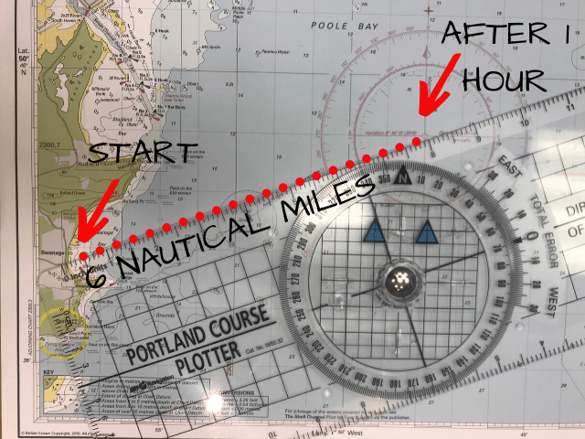
Most Probable Position
-In the event of a loss of electronic systems, we may need to establish the Most Probable Position. -This will usually be the most recent fix taken with a Dead Reckon applied. -If there is conflicting information, more information may be needed. -An MPP can be determined by applying a single LOP to a DR, lines of soundings, LOPs that are somewhat inconsistent, or from a DR with a correction from set and drift. -A series of EPs may be inconsistent, but it is good practice to plot all MPPs. Try to maintain a separate EP plot if this is the case. -An MPP can help the ship find a safe course!
SEANAV I United States Naval Academy
NN220 – Fundamentals of Navigation
Operations Officer I HMS PROTECTOR A173 I The Ice Patrol Ship

Slide 13
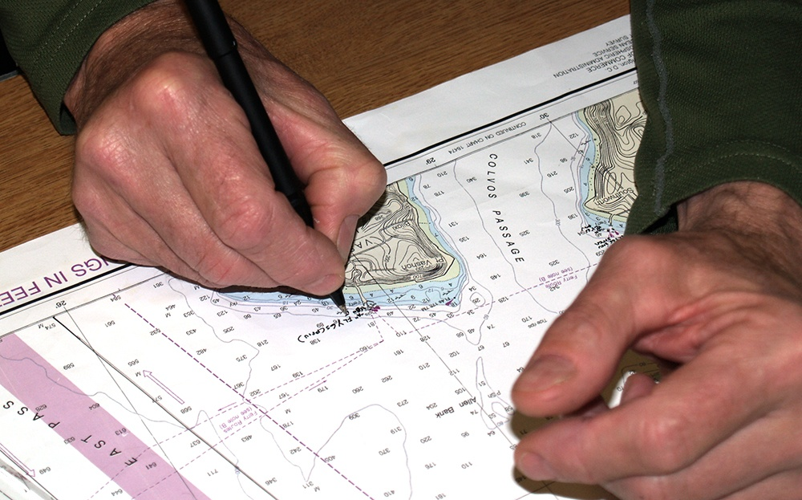
Plotting
-Once you have a fix or an MPP, you should immediately begin plotting onto a chart or plotting sheet to maintain the plot. -As we have discussed, the US Navy has stated that the use of paper charts is not allowed on surface ships. -Most ships do not have the paper charts needed to complete a transit in or out of port. -The Emergency Navigation Laptop, or ENL, is the backup system that a US Navy ship would use as an alternative plot. -However, if exposed to the elements or without a reliable power source, the ENL will fail in time. -How can a ship plot a position without charts or plotting sheets?
SEANAV I United States Naval Academy
NN220 – Fundamentals of Navigation
Operations Officer I HMS PROTECTOR A173 I The Ice Patrol Ship

Slide 14
Plotting Sheets
-If Plotting Sheets are not available, a Mercator plotting sheet can be constructed.
-This process is broken down into two methods.
-Both methods are based upon a graphical solution of the secant of the latitude, which approximates the expansion of latitude.
SEANAV I United States Naval Academy
NN220 – Fundamentals of Navigation
Operations Officer I HMS PROTECTOR A173 I The Ice Patrol Ship

Slide 15
Method #1
Step one: Draw a series of equally spaced vertical lines at any spacing desired. These are the meridians; label them at any desired interval, such as 1', 2', 5', 10', 30', 1°, etc.
Step two: Draw and label a horizontal line through the center of the sheet to represent the parallel of the mid-latitude of the area.
Step three: Through any convenient point, such as the intersection of the central meridian and the parallel of the mid-latitude, draw a line making an angle with the horizontal equal to the mid-latitude.
Step four: Draw in and label additional parallels. The length of the oblique line between meridians is the perpendicular distance between parallels, as shown by the broken arc. The number of minutes of arc between parallels is the same as that between the meridians.
Step five: Graduate the oblique line into convenient units. If 1' is selected, this scale serves as both a latitude and mile scale. It can also be used as a longitude scale by measuring horizontally from a meridian instead of obliquely along the line.
SEANAV I United States Naval Academy
NN220 – Fundamentals of Navigation
Operations Officer I HMS PROTECTOR A173 I The Ice Patrol Ship

Slide 16
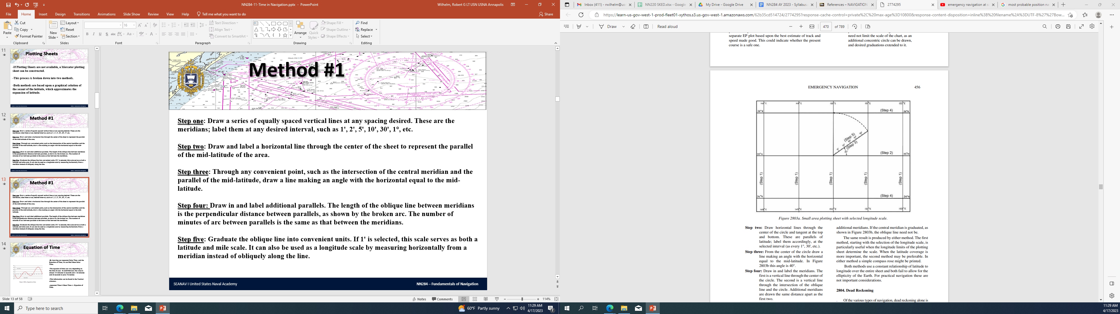
Method #1
Step one: Draw a series of equally spaced vertical lines at any spacing desired. These are the meridians; label them at any desired interval, such as 1', 2', 5', 10', 30', 1°, etc.
Step two: Draw and label a horizontal line through the center of the sheet to represent the parallel of the mid-latitude of the area.
Step three: Through any convenient point, such as the intersection of the central meridian and the parallel of the mid-latitude, draw a line making an angle with the horizontal equal to the mid-latitude.
Step four: Draw in and label additional parallels. The length of the oblique line between meridians is the perpendicular distance between parallels, as shown by the broken arc. The number of minutes of arc between parallels is the same as that between the meridians.
Step five: Graduate the oblique line into convenient units. If 1' is selected, this scale serves as both a latitude and mile scale. It can also be used as a longitude scale by measuring horizontally from a meridian instead of obliquely along the line.
SEANAV I United States Naval Academy
NN220 – Fundamentals of Navigation
Operations Officer I HMS PROTECTOR A173 I The Ice Patrol Ship

Slide 17
Method #2
Step one: At the center of the sheet draw a circle with a radius equal to 1° (or any other convenient unit) of latitude at the desired scale. If a sheet with a compass rose is available, as in Figure 2803b, the compass rose can be used as the circle and will prove useful for measuring directions. It need not limit the scale of the chart, as an additional concentric circle can be drawn, and desired graduations extended to it.
Step two: Draw horizontal lines through the center of the circle and tangent at the top and bottom. These are parallels of latitude; label them accordingly, at the selected interval (as every 1°, 30', etc.).
Step three: From the center of the circle draw a line making an angle with the horizontal equal to the mid-latitude. In Figure 2803b this angle is 40°.
Step four: Draw in and label the meridians. The first is a vertical line through the center of the circle. The second is a vertical line through the intersection of the oblique line and the circle. Additional meridians are drawn the same distance apart as the first two.
Step five: Graduate the oblique line into convenient units. If 1' is selected, this scale serves as a latitude and mile scale. It can also be used as a longitude scale by measuring horizontally from a meridian, instead of obliquely along the line.
SEANAV I United States Naval Academy
NN220 – Fundamentals of Navigation
Operations Officer I HMS PROTECTOR A173 I The Ice Patrol Ship

Slide 18
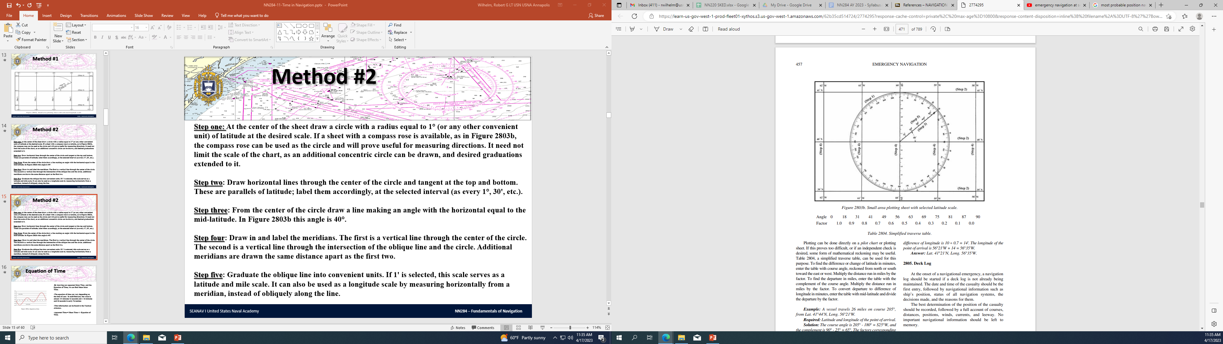
Method #2
SEANAV I United States Naval Academy
NN220 – Fundamentals of Navigation
Operations Officer I HMS PROTECTOR A173 I The Ice Patrol Ship

Slide 19
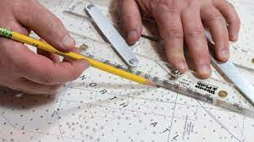
Dead Reckoning
-Once a position is plotted, a Navigator should continue standard practices. -Dead Reckoning is always available in some form. -Keep a close check on speed, direction and distance made good. -Evaluate wind and current and the effect it has on position. -A good Dead Reckon may actually be a more accurate position than one determine by inaccurate LOPs. -If the means of determining direction and distance are accurate, it may be best to adjust DR only after a confident fix.
SEANAV I United States Naval Academy
NN220 – Fundamentals of Navigation
Operations Officer I HMS PROTECTOR A173 I The Ice Patrol Ship

Slide 20
Dead Reckoning
-Plotting can be done directly onto a pilot chart or plotting sheet.
-Mathematical reckoning can also be used, where we use how a function of time, speed and distance to find how far we have traveled from an initial position and convert that distance to a Lat/Long.
SEANAV I United States Naval Academy
NN220 – Fundamentals of Navigation
Operations Officer I HMS PROTECTOR A173 I The Ice Patrol Ship

Slide 21
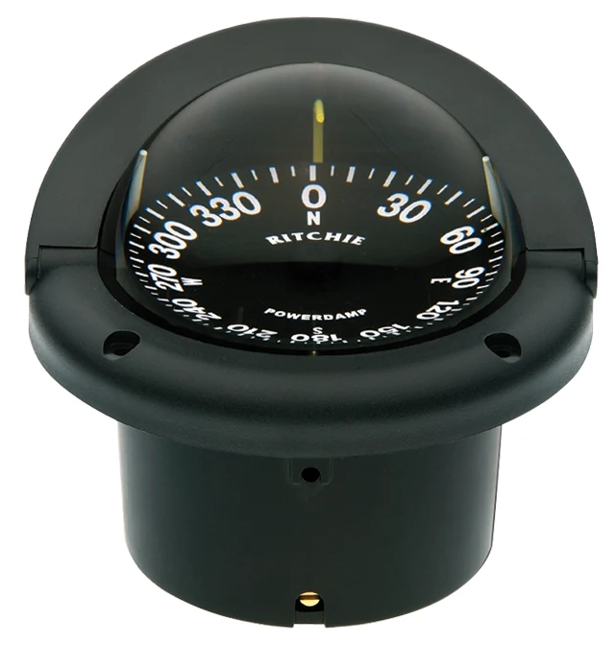
Direction
-Direction is one of the essential elements of Dead Reckoning. A compass would be used to determine a ship’s heading. -Any deviations for a compass used should be determined before use. -A gyrocompass is preferable, but if unavailable than a bridge or lifeboat magnetic compass will suffice. -If a Nautical Almanac is available, and we Have an accurate Greenwich Time, we can determine the azimuth, or bearing, of any Celestial Body.
SEANAV I United States Naval Academy
NN220 – Fundamentals of Navigation
Operations Officer I HMS PROTECTOR A173 I The Ice Patrol Ship

Slide 22
Finding Direction
-Several unique situations occur with CELNAV that will allow us to determine azimuth without computations. -We will cover several methods to determine true directions!
SEANAV I United States Naval Academy
NN220 – Fundamentals of Navigation
Operations Officer I HMS PROTECTOR A173 I The Ice Patrol Ship

Slide 23
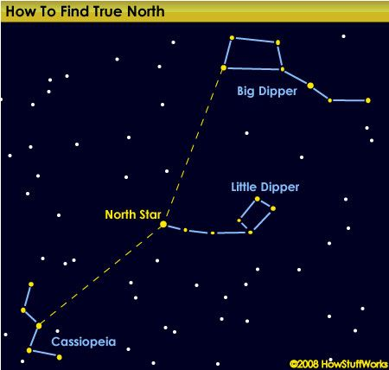
Polaris
-Polaris is always within 2° of True North for observers between the Equator and about 60° North. -If you can find the azimuth to Polaris, you will know True North! -There is a small variation in the bearing, between 358°-002°
SEANAV I United States Naval Academy
NN220 – Fundamentals of Navigation
Operations Officer I HMS PROTECTOR A173 I The Ice Patrol Ship

Slide 24
Polaris
-This variation can be determined by knowing the position of the Big Dipper and Cassiopeia. -When the trailing star of the Big Dipper and Cassiopeia form a horizontal line with Polaris, the maximum correction of 2° applies. -If Cassiopeia is to the left of Polaris, the azimuth of Polaris is 358°-359° and if to the right, 001°-002°.
SEANAV I United States Naval Academy
NN220 – Fundamentals of Navigation
Operations Officer I HMS PROTECTOR A173 I The Ice Patrol Ship

Slide 25
Meridian Transit
-Any Celestial Body bears due North or South at Meridian Transit, either through an Upper or Lower Transit. -This is the moment of maximum (or minimum) altitude. -The instant of Meridian Transit may be difficult to determine, due to a nearly constant altitude and considerably changing azimuth. -If time, the Nautical Almanac, and Longitude are available, the time of transit can be computed.
SEANAV I United States Naval Academy
NN220 – Fundamentals of Navigation
Operations Officer I HMS PROTECTOR A173 I The Ice Patrol Ship

Slide 26
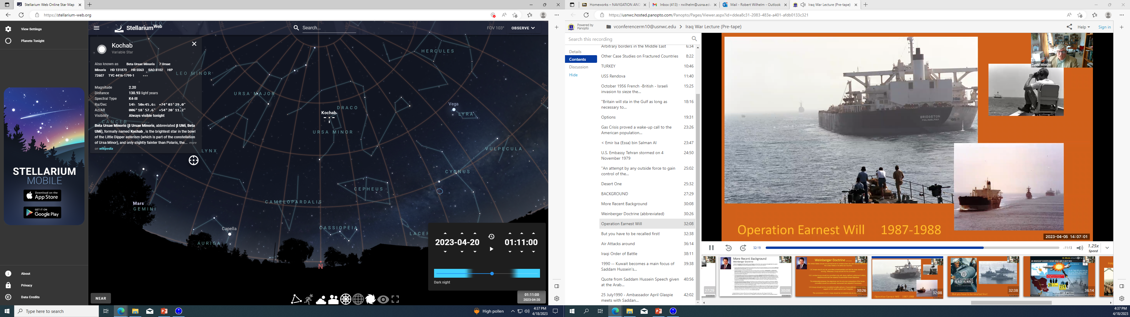
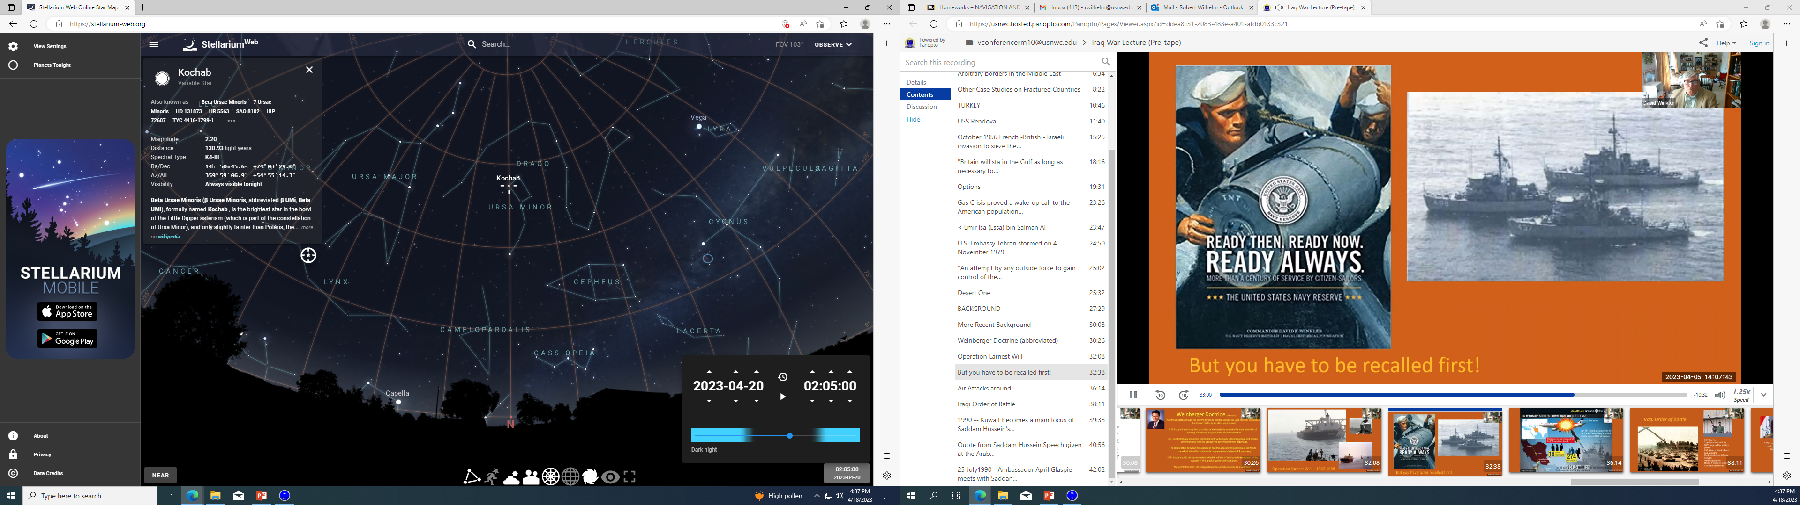
Meridian Transit
Red Line
=
Our Meridian
Altitude = 54° 34’ or just before Meridian Transit
Altitude = 54° 55’
MERIDIAN TRANSIT or North (as the star went from Right to Left)!
SEANAV I United States Naval Academy
NN220 – Fundamentals of Navigation
Operations Officer I HMS PROTECTOR A173 I The Ice Patrol Ship

Slide 27
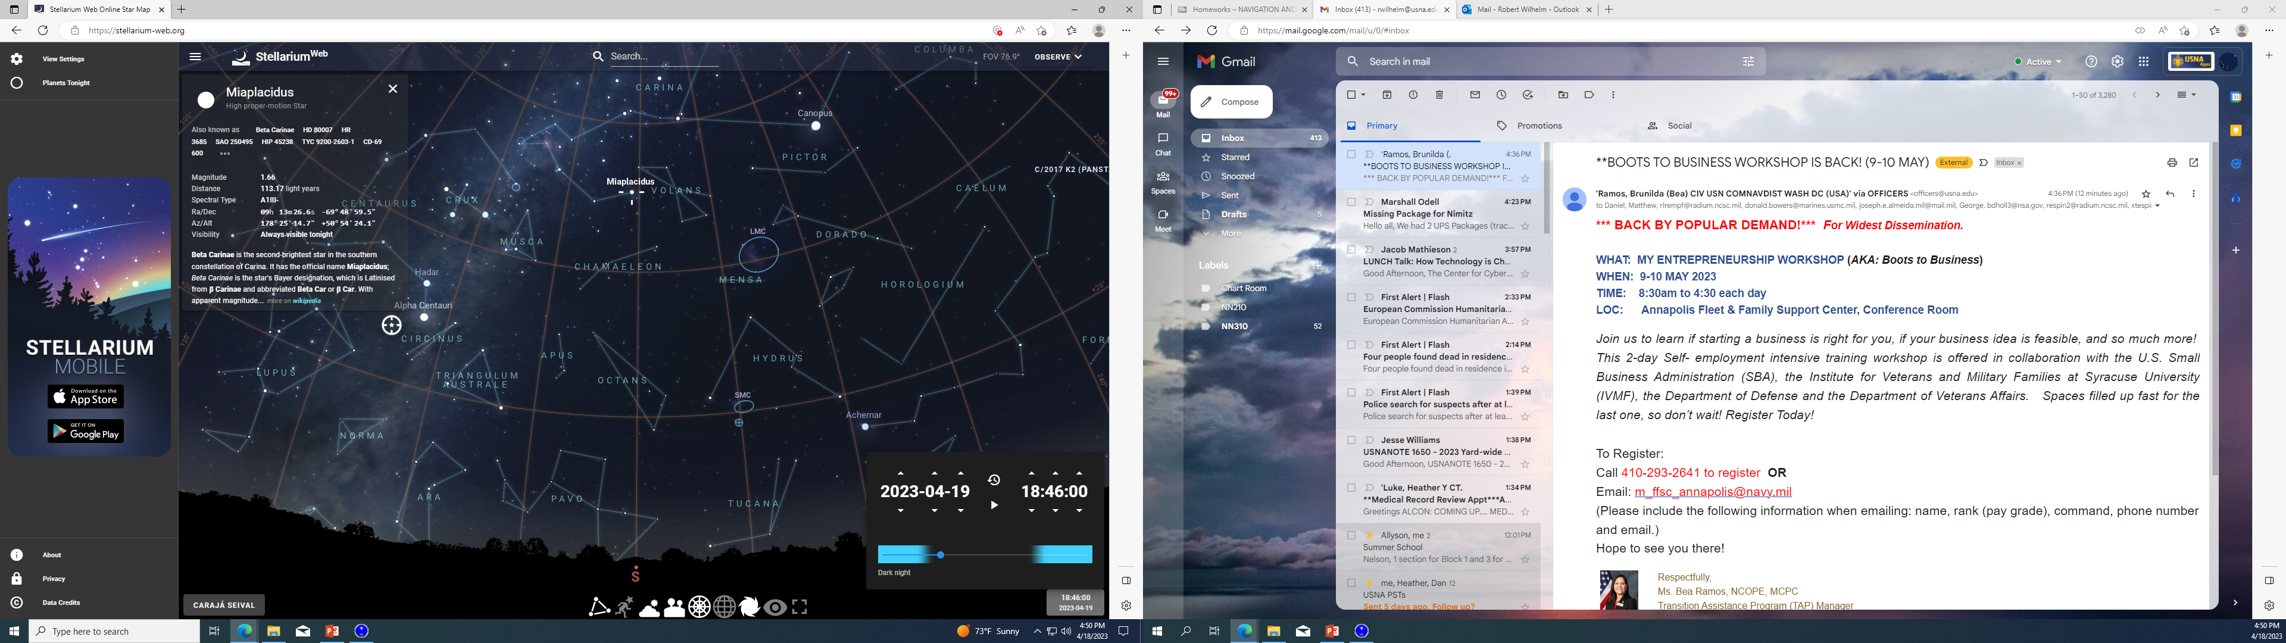
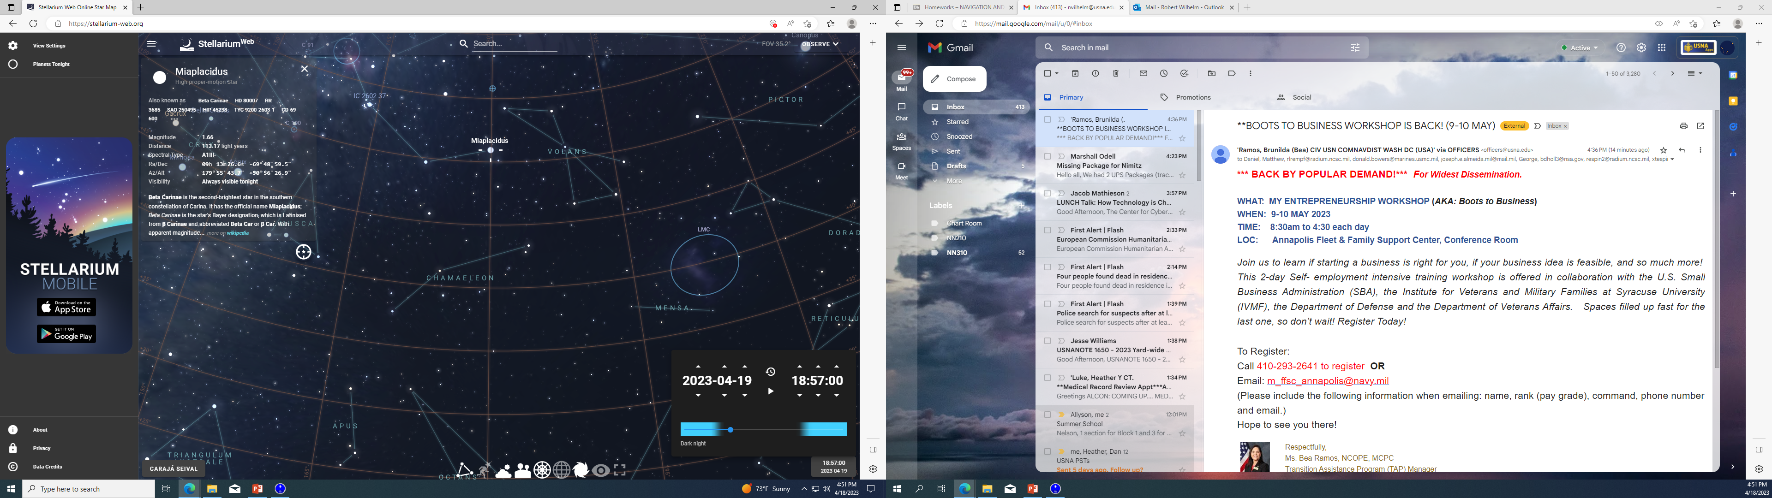
Meridian Transit
Red Line
=
Our Meridian
Altitude = 50° 54’ or just before Meridian Transit
Altitude = 50° 56’
MERIDIAN TRANSIT or South (as the star went from Left to Right)!
SEANAV I United States Naval Academy
NN220 – Fundamentals of Navigation
Operations Officer I HMS PROTECTOR A173 I The Ice Patrol Ship

Slide 28
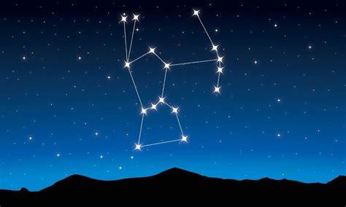
Body at Prime Vertical
-Prime Vertical is the Great Circle that passes East and West through the zenith of a specific location, typically an observer’s position. -If any method is available for determining when a Celestial Body is on the prime vertical, you can know either East or West. -Table 20 in Bowditch Vol. II called the Meridian Angle and Altitude of a Body on Prime Vertical, provides this information. -Let’s look at an example…the star Mintaka.
SEANAV I United States Naval Academy
NN220 – Fundamentals of Navigation
Operations Officer I HMS PROTECTOR A173 I The Ice Patrol Ship

Slide 29
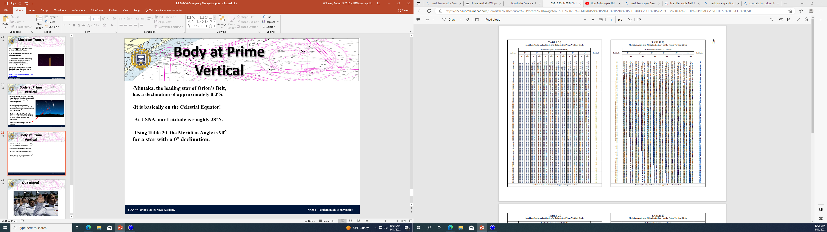
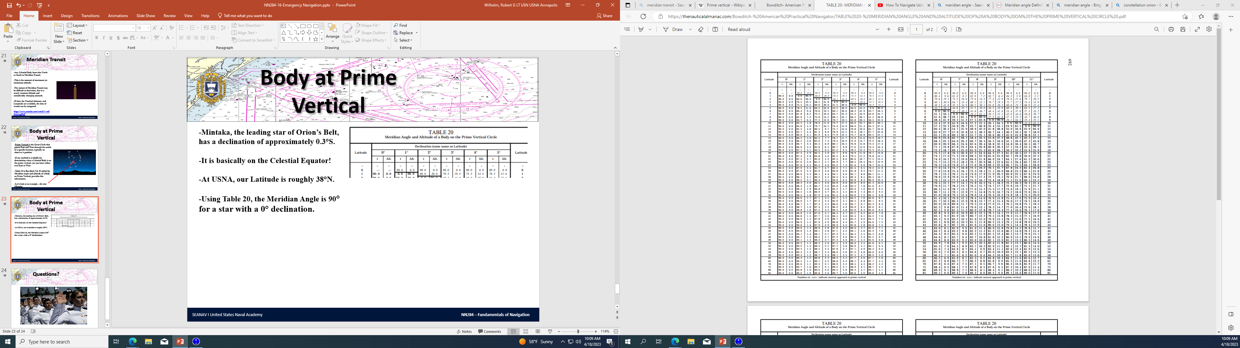
Body at Prime Vertical
-Mintaka, the leading star of Orion’s Belt, has a declination of approximately 0.3°S. -It is basically on the Celestial Equator. -At USNA, our Latitude is roughly 39°N. -Using Table 20, the Meridian Angle is 90° for a star with a 0° declination, and will have a 0° Altitude. -This means that Mintaka will be on the Prime Vertical when its Meridian Angle is 90°, or the angle between the Observer’s Meridian and the Hour Circle of the Celestial Body. -When Mintaka is on the Prime Vertical, it bears 090° or 270°, but it will be on the Horizon. -Stars rise in the East and set in the West.
SEANAV I United States Naval Academy
NN220 – Fundamentals of Navigation
Operations Officer I HMS PROTECTOR A173 I The Ice Patrol Ship

Slide 30
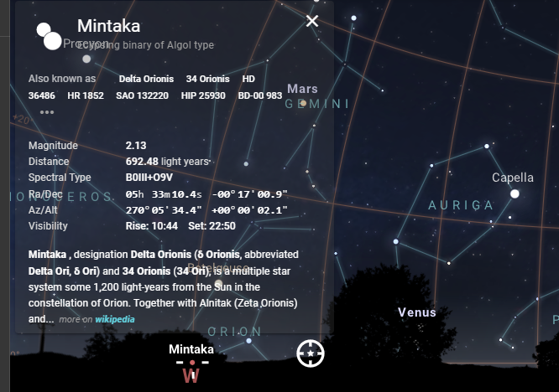
Body at Prime Vertical
-Mintaka bears due west, or where it sets!
-You can see that its Azimuth is approx. 270° and the Altitude is approx. 0 ° or just on the horizon.
https://stellarium-web.org/
SEANAV I United States Naval Academy
NN220 – Fundamentals of Navigation
Operations Officer I HMS PROTECTOR A173 I The Ice Patrol Ship

Slide 31
Body at Rising or Setting
-Except for the Moon, the azimuth of a celestial body is almost the same at rising as it is at setting. -If the azimuth is measured both at rising and setting, true south or true north (depending on which hemisphere you are in) is midway between the two observed values. Example ARCTURUS Rise = Azimuth 065.29° Set = Azimuth 294.88° Midway is approximately 000.085° or North!
SEANAV I United States Naval Academy
NN220 – Fundamentals of Navigation
Operations Officer I HMS PROTECTOR A173 I The Ice Patrol Ship

Slide 32
Body at Rising or Setting
-Additionally, the difference between the azimuths taken at rise and set can determine compass error. Example The Azimuth of a Celestial Body at Rise is 073° PGC The Azimuth of a Celestial Body at Set is 277° PGC (073+277)/2=175° You have a 5° Easterly Error on your Compass as it should equal 180°!
SEANAV I United States Naval Academy
NN220 – Fundamentals of Navigation
Operations Officer I HMS PROTECTOR A173 I The Ice Patrol Ship

Slide 33
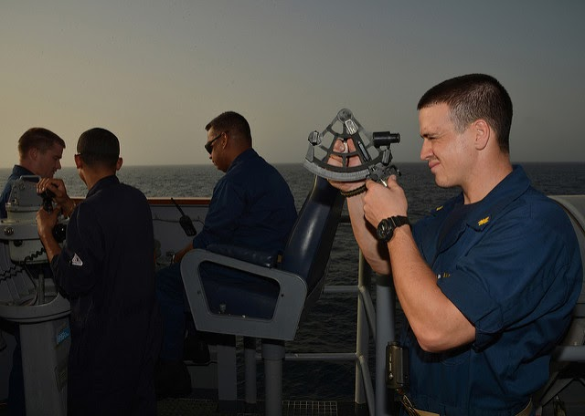
Emergency CELNAV
-Celestial Navigation is an essential skillset in an emergency navigation situation. -The lack of traditional NAVAIDs in Coastal and Open Ocean waters means that there is no reliable alternative. -Subsequently, the absence of light and other man-made pollutions at sea means the night sky is more visible. -Simple CELNAV practices can determine both latitude and longitude. -These practices can save lives!
SEANAV I United States Naval Academy
NN220 – Fundamentals of Navigation
Operations Officer I HMS PROTECTOR A173 I The Ice Patrol Ship

Slide 34
Determining Latitude
-We have covered how to use basic CELNAV practice to determine heading/bearings. -Now we will demonstrate how we can use CELNAV to find our Latitude.
SEANAV I United States Naval Academy
NN220 – Fundamentals of Navigation
Operations Officer I HMS PROTECTOR A173 I The Ice Patrol Ship

Slide 35

Meridian Altitude
-Latitude can be determined using a meridian altitude of any celestial body, if the declination is known. -If accurate time, knowledge of longitude, and an almanac is available, the observation can be made at the correct moment. -Does this sound familiar?
SEANAV I United States Naval Academy
NN220 – Fundamentals of Navigation
Operations Officer I HMS PROTECTOR A173 I The Ice Patrol Ship

Slide 36
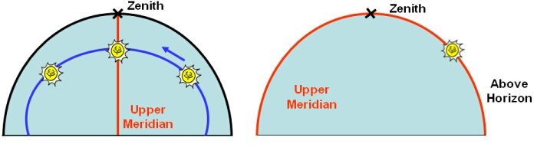
Meridian Altitude
-The process is very similar to Local Apparent Noon (LAN) or MERPASS. -The Latitude check is done by knowing the declination of the Celestial Body and the CO-ALT! Use the Upper Transit of a Celestial Body.
SEANAV I United States Naval Academy
NN220 – Fundamentals of Navigation
Operations Officer I HMS PROTECTOR A173 I The Ice Patrol Ship

Slide 37
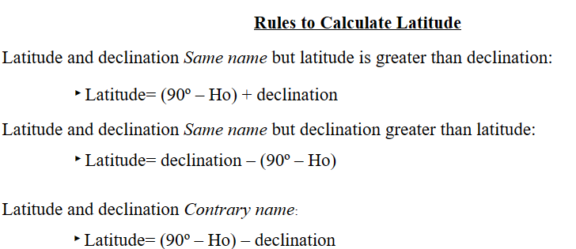
Meridian Altitude
SEANAV I United States Naval Academy
NN220 – Fundamentals of Navigation
Operations Officer I HMS PROTECTOR A173 I The Ice Patrol Ship

Slide 38
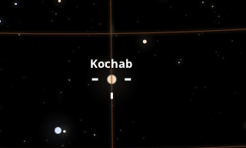
Meridian Altitude
Kochab is on our Meridian
SEANAV I United States Naval Academy
NN220 – Fundamentals of Navigation
Operations Officer I HMS PROTECTOR A173 I The Ice Patrol Ship

Slide 39
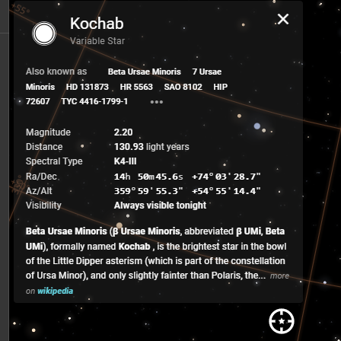
Meridian Altitude
Kochab’s declination is roughly 74°N.
CO-ALT is 35°.
74°N-35°=39°N…our Latitude!
SEANAV I United States Naval Academy
NN220 – Fundamentals of Navigation
Operations Officer I HMS PROTECTOR A173 I The Ice Patrol Ship

Slide 40
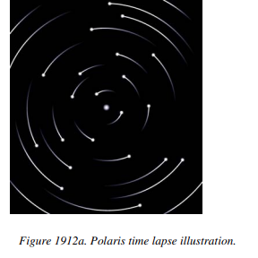
Latitude by Polaris
-With a few minor corrections, the Altitude if Polaris is equal to the observer’s latitude. -When Polaris is at the exact same altitude as the Pole, the correction is 0. -Subsequently, when Polaris is on the Observer’s Meridian (either Upper or Lower), the correction is maximum. -There is a Strip Form available to find the error, however in an emergency situation the altitude of Polaris is enough to determine a useable Latitude.
SEANAV I United States Naval Academy
NN220 – Fundamentals of Navigation
Operations Officer I HMS PROTECTOR A173 I The Ice Patrol Ship

Slide 41
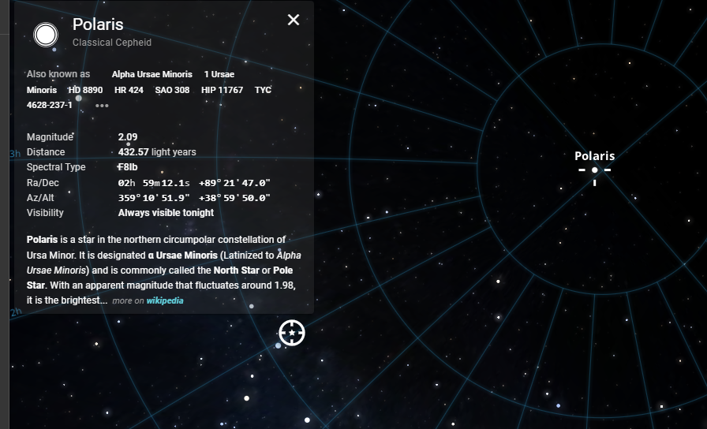
Latitude by Polaris
The Altitude is our Latitude!
SEANAV I United States Naval Academy
NN220 – Fundamentals of Navigation
Operations Officer I HMS PROTECTOR A173 I The Ice Patrol Ship

Slide 42
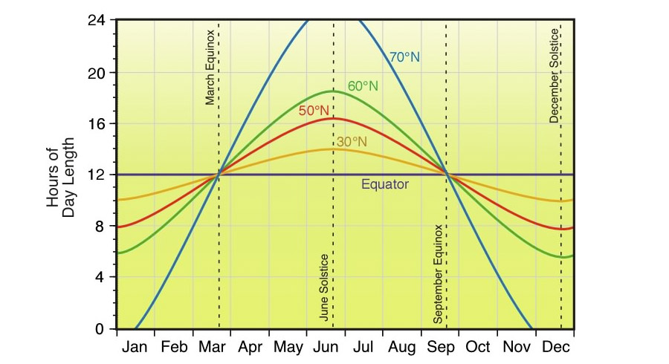
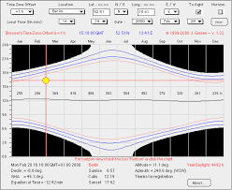
Length of Day
-Length of Day varies with latitude. -That is why higher latitudes can experience longer or shorter days than those closer to the equator. -Latitude can be determined if the elapsed time between sunrise and sunset can be accurately observed. -The latitude determined by length of day is the value for the time of meridian transit. -Since meridian transit occurs at midday, half the interval may be observed, then doubled.
SEANAV I United States Naval Academy
NN220 – Fundamentals of Navigation
Operations Officer I HMS PROTECTOR A173 I The Ice Patrol Ship

Slide 43
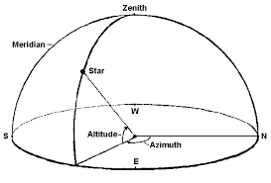
Body in Zenith
-The declination of a Body in Zenith is equal to the latitude of an observer. -If no means are available to measure altitude, the position of the zenith can be determined by holding a weight string overheard to mark your zenith.
SEANAV I United States Naval Academy
NN220 – Fundamentals of Navigation
Operations Officer I HMS PROTECTOR A173 I The Ice Patrol Ship

Slide 44
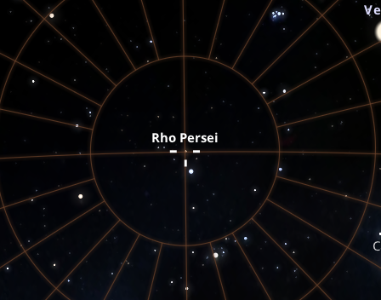
Body in Zenith
The Star Rho Persei is on our Zenith, as marked by the crosshairs.
SEANAV I United States Naval Academy
NN220 – Fundamentals of Navigation
Operations Officer I HMS PROTECTOR A173 I The Ice Patrol Ship

Slide 45
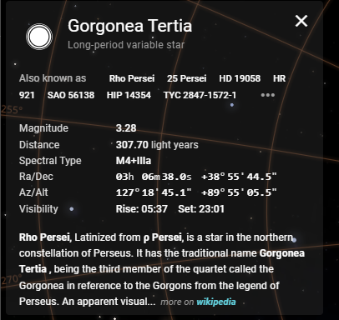
Body in Zenith
The Star Rho Persei has a declination of 38° 55’ 45’’.
This is our Latitude!
SEANAV I United States Naval Academy
NN220 – Fundamentals of Navigation
Operations Officer I HMS PROTECTOR A173 I The Ice Patrol Ship

Slide 46
Determining Longitude
-Unlike latitude, determining longitude requires accurate Greenwich time. -All such methods consists of noting the Greenwich time at which a phenomenon occurs locally. -We would need the GMT time at which a phenomenon occurs to be able to determine longitude this way.
SEANAV I United States Naval Academy
NN220 – Fundamentals of Navigation
Operations Officer I HMS PROTECTOR A173 I The Ice Patrol Ship

Slide 47
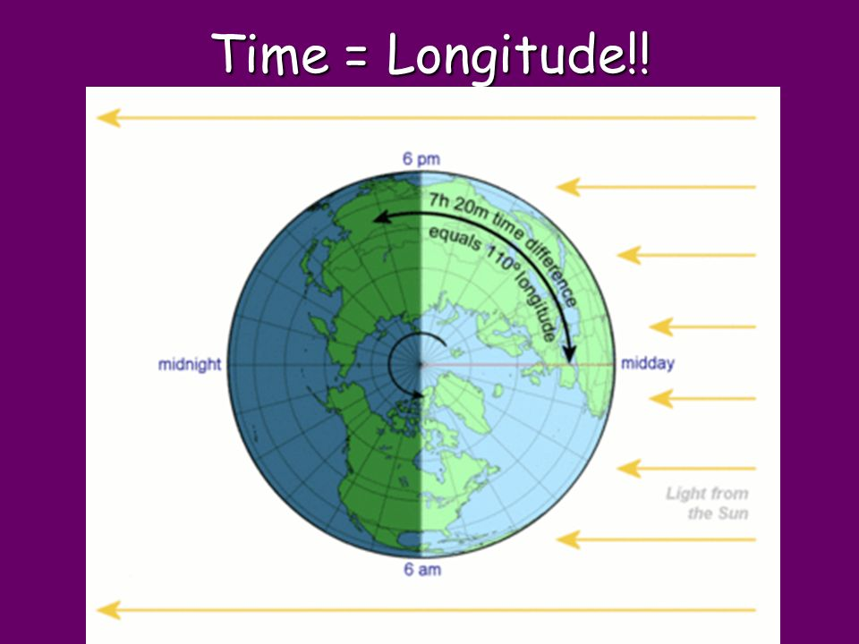
Time of Transit
-When a body is on the local celestial meridian, its GHA is the same as the longitude of the observer in west longitude, or 360-λ in an east longitude. -Thus, the GMT of local time of transit is determined and if a table of GHAs (or time of transit of the Greenwich Meridian) is available, longitude can be determined!
SEANAV I United States Naval Academy
NN220 – Fundamentals of Navigation
Operations Officer I HMS PROTECTOR A173 I The Ice Patrol Ship

Slide 48
Time of Transit
-Let’s work an example. -On 20APR23 at 0103 local time, Alkaid reaches its maximum altitude as it crosses our meridian. -We know we are on the East Coast and out time zone is +4Q at the moment. Additionally, this means that we know we are in a West Longitude. -We have the Nautical Almanac, and we can do a quick check to verify our Longitude!
SEANAV I United States Naval Academy
NN220 – Fundamentals of Navigation
Operations Officer I HMS PROTECTOR A173 I The Ice Patrol Ship

Slide 49
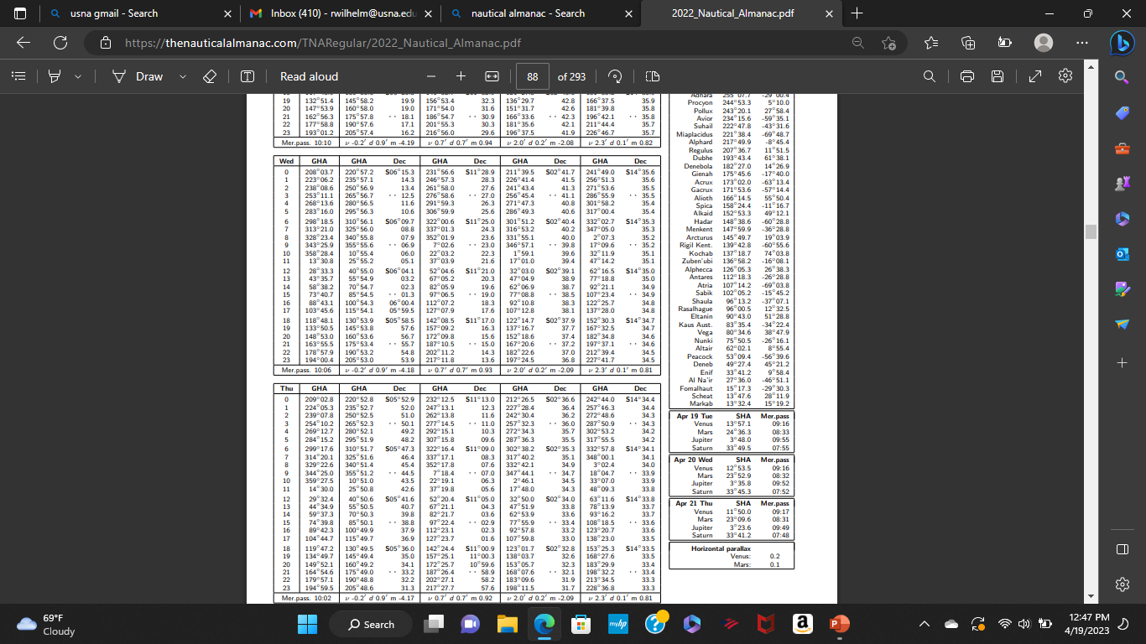
Time of Transit
The GHA for the First Point of Aries and the SHA for Alkaid.
SEANAV I United States Naval Academy
NN220 – Fundamentals of Navigation
Operations Officer I HMS PROTECTOR A173 I The Ice Patrol Ship

Slide 50
Time of Transit
-From the STELLA snapshot, we can see that at 0103Q or 0503 GMT on 20APR2023, the GHA for Alkaid is 76° 39.6’. -Since we know we are in a western hemisphere, we know our longitude is 076° 39.6’ W!
SEANAV I United States Naval Academy
NN220 – Fundamentals of Navigation
Operations Officer I HMS PROTECTOR A173 I The Ice Patrol Ship

Slide 51
Break
-Take 10 minutes and relax your brain!
SEANAV I United States Naval Academy
NN220 – Fundamentals of Navigation
Operations Officer I HMS PROTECTOR A173 I The Ice Patrol Ship

Slide 52
Mitigating Emergencies
-With the concepts you have learned throughout the course, you have built a foundation from which you can safely navigate across a variety of unique and challenging circumstances.
-The process is never finished…we must continue to practice and build our level of knowledge. Navigation is a perishable skill!
-Based on what you have learned , what are some things that you can do to mitigate navigation emergencies?
SEANAV I United States Naval Academy
NN220 – Fundamentals of Navigation
Operations Officer I HMS PROTECTOR A173 I The Ice Patrol Ship

Slide 53
Mitigating Emergencies
-Practice varying ways of safely navigating!
-Calibrate your equipment often.
-Verify equipment accuracy by routinely cross checking your navigation sensors or equipment.
-Keep backup navigation systems.
-Train your relief.
-Build your knowledge!
SEANAV I United States Naval Academy
NN220 – Fundamentals of Navigation
Operations Officer I HMS PROTECTOR A173 I The Ice Patrol Ship

Slide 54
Enabling Objectives
1 – DESCRIBE how to plan for navigational emergencies when at sea. 2- DESCRIBE the contents of an emergency navigation kit. 3 - DEFINE the Most Probably Position (MPP) and understand how to determine MPP. 4 - UNDERSTAND how Dead Reckoning applies to emergency navigation. 5 - DETERMINE the ship’s direction using Polaris, Meridian Transit, Body on Prime Vertical, and Body at Rising or Setting methods. 7 - UNDERSTAND how Celestial Navigation applies to emergency navigation. 8 - DETERMINE Latitude by Meridian Altitude, Latitude by Polaris, the Length of the Day, and the Body In Zenith methods. 9 - DETERMINE Longitude by Time of Transit method. 10 - UTILIZE concepts learned in the course to determine mitigating factors to avoid an emergency at sea.
SEANAV I United States Naval Academy
NN220 – Fundamentals of Navigation
Operations Officer I HMS PROTECTOR A173 I The Ice Patrol Ship

Slide 55
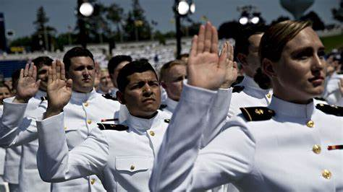
Questions?
SEANAV I United States Naval Academy
NN220 – Fundamentals of Navigation
Operations Officer I HMS PROTECTOR A173 I The Ice Patrol Ship

